Slide 1
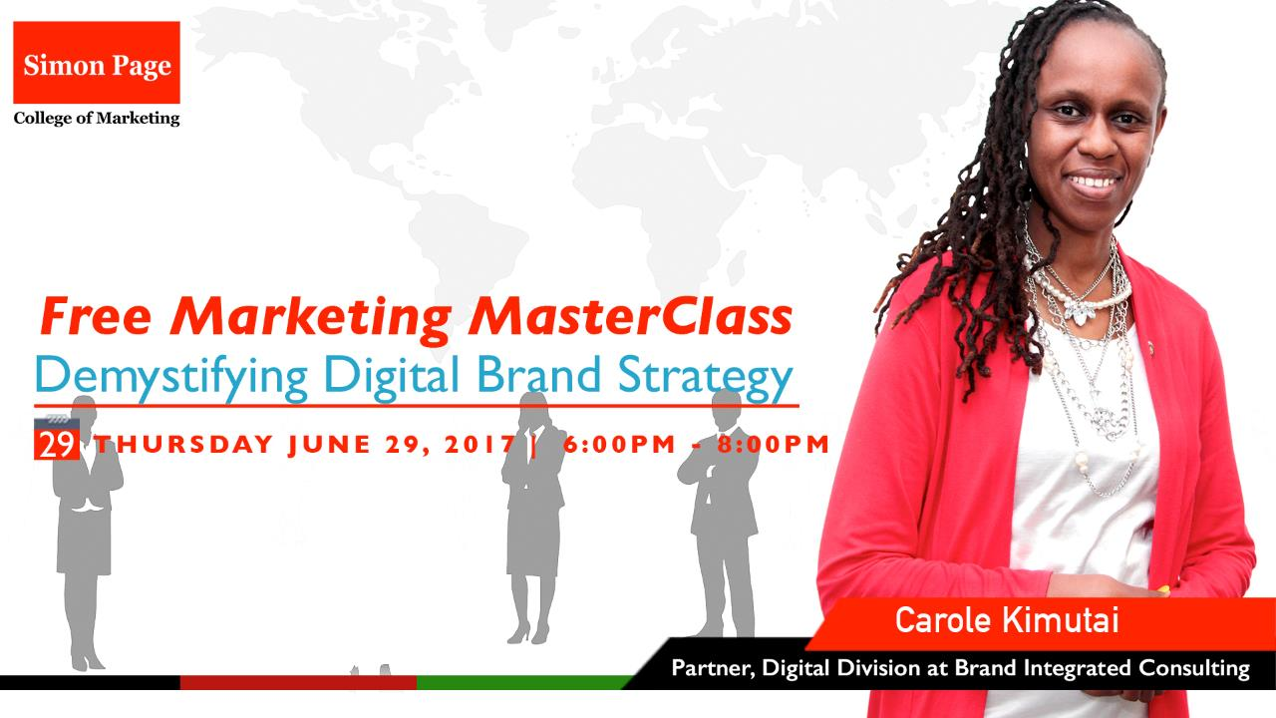

Slide 2
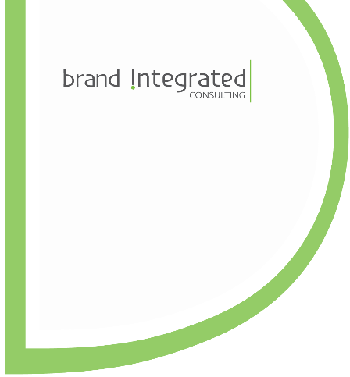

Demystifying Digital Brand Strategy
Presented by: Carole J. Kimutai
Partner, Digital Division – Brand Integrated Consulting

Slide 3
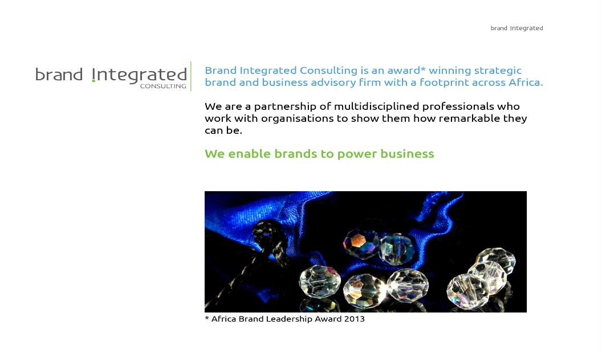

Slide 4
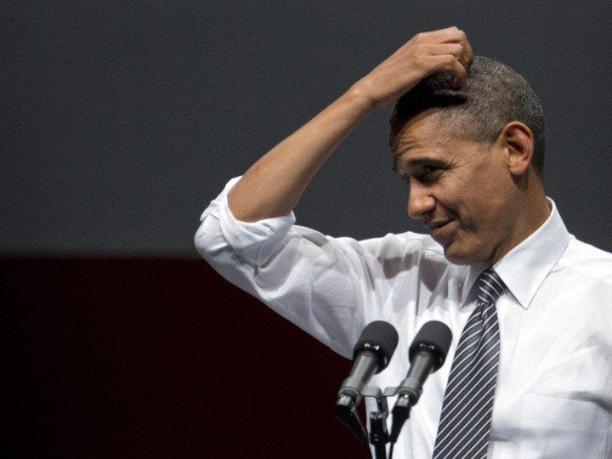
What is a BRAND?

Slide 5

A brand is a promise made and a promise kept

Slide 6
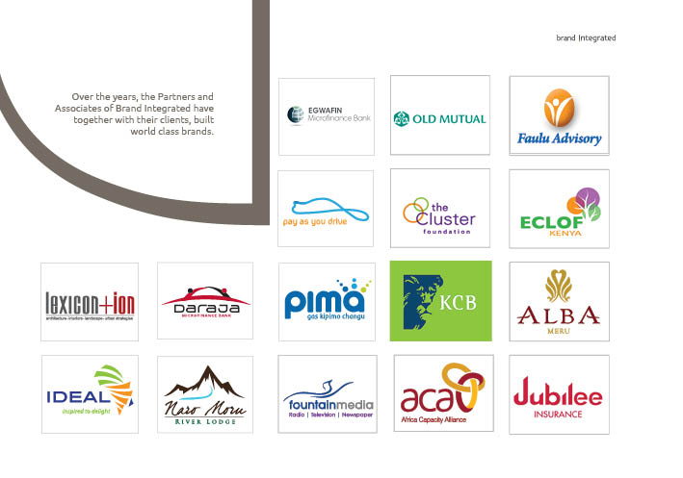

Slide 7
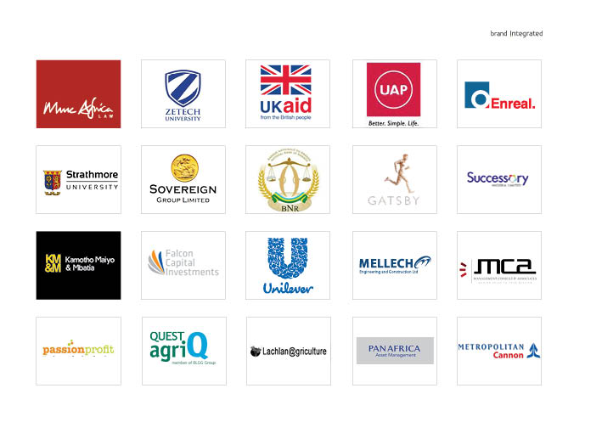

Slide 8
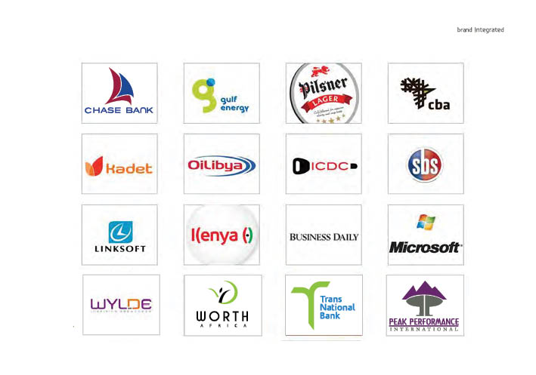

Slide 9
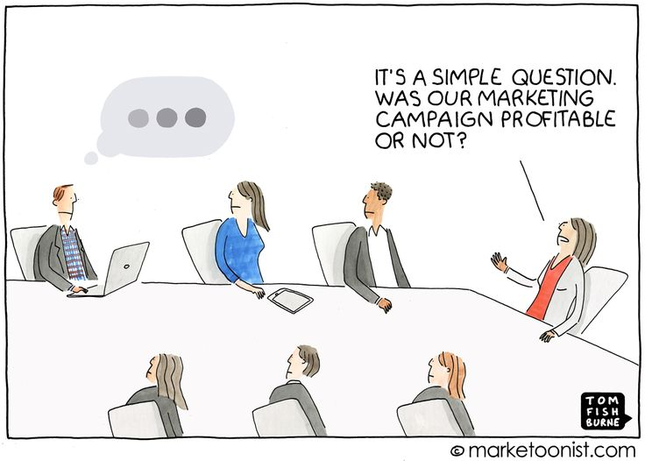
The MILLION dollar question…

Slide 10
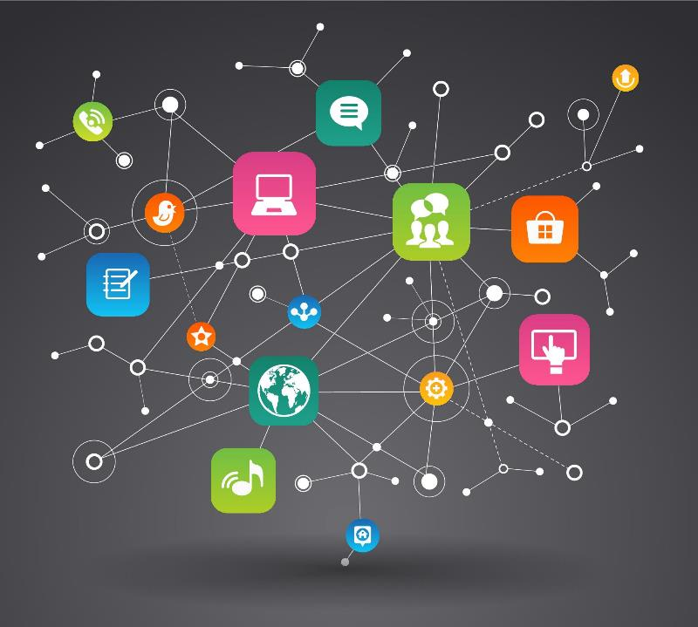
Objectives of the Master Class
Defining a digital brand/marketing strategy
How to know that digital marketing is right for your business
Understanding your market and “online” customers

Slide 11
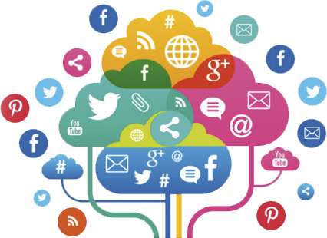
A case for Digital
Digital marketing is the promotion of products or brands
via one or more forms of internet media.
Digital marketing differs from traditional marketing in that it involves the use of channels and methods that enable an organization
to analyze marketing campaigns and understand what is working and what isn’t – typically
in real time.

Slide 12

Why digital advertising?
#1. Easy
to access
#3. Marketing Effectiveness
#2. Competitive advantage

Slide 13
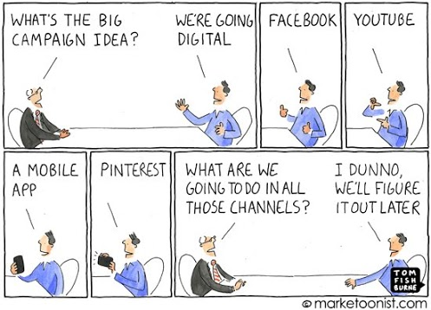
What is your STRATEGY?

Slide 14
Should you go digital?
You need to answer these TWO questions:
Are your current and potential customers online/ are they going to be online? You must understand the habits of your customers – where they get information from, how they buy and pay, and where they spend their most time.
Are your products/services/brands suited for digital marketing? As long as you answer Q1, then you should be promoting online. There are some brands best suited for online like EBooks, hotels.

Slide 15
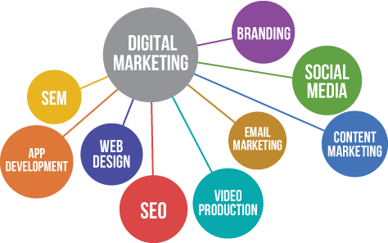
The thrust of a Digital strategy
For you to succeed, you need to understand:
Have the BRAND at the centre. A digital marketing strategy should be done based on a clear BRAND strategy.
Know your market
How your customers are using digital technology

Slide 16
Build awareness on other sites and drive web presence.
Digital communication circle – continuous relations with your customer
Build awareness on other sites and drive web presence.
Metrics: fans / followers, visitors, inbound links.
Build Customer and fan relationship through time to achieve retention goals.
Metrics: referral, repeat purchase.
REACH
ACT
CONVERT
ENGAGE
Achieve conversion to marketing goals (funs, leads, sales) on web presence. Metrics: orders, revenue, average order value.
Engage audience with brand on its website or other online presence. Metrics: time on site, shares, comments, likes, leads.

Slide 17

Sadly, no “one size fits all” – different products, different markets, different needs.
Your strategy provides you with a bird’s eye view of your digital marketing landscape with your business at the centre!

Slide 18
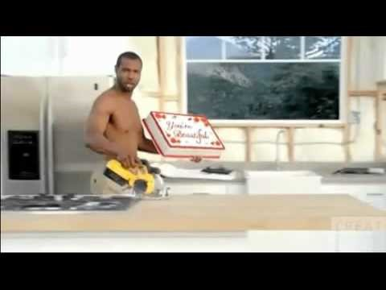
Case Study: Old Spice Campaign
https://www.youtube.com/watch?v=S0Ei6WQkjUY
Notes:
https://www.youtube.com/watch?v=S0Ei6WQkjUY

Slide 19
The OLD SPICE Strategy
A humorous monologue: “Anything is possible when your man smells like Old Spice and not a lady.”
Launched days prior to the Super Bowl and premiering on television the day after the big game.
The ad helped the brand capture 75% of all conversations in this category - became a cultural phenomenon.
Appealed to their core target (guys) and for the first time to a female audience.
Would “Old Spice” be relevant to young men moving forward?
They turned this perceived weakness into a strength. Women were responsible for more than 50% body wash purchases. The campaign wanted to speak to men and women simultaneously.

Slide 20
Response campaign
With any young target audience, you have to find new and interesting ways to engage with them.
Be entertaining, relevant and, humorous. Digital helps you to quickly gauge the reaction as users provide feedback to the advertising.
Tap into existing behaviours online rather than creating new ones. Many fans of the first ad had viewed it on YouTube and posted enthusiastic comments online.
The idea: The Old Spice Guy would personally respond to fans’ messages and comments posted across a variety of social media, including Facebook and Twitter, through a series of video messages accessed via YouTube.

Slide 21
The pitch and tone of the character was key to the success of the response videos and something the Old Spice Guy—a man who is witty and charismatic, manly and athletic, but doesn’t take himself too seriously—had already established and made popular with fans.
Campaign moved from mass media TV, print and digital to engagement—still targeting the same audience, but deepening the communication and similarly the relationship.
Biggest lesson: Keep your creative ideas simple. Don't over-complicate things.

Slide 22
Laying strong digital foundations
Know your business/brand – Are your products suited for online promotion? Do you have the right infrastructure/technology/skills in place? How will digital marketing fit in your existing business processes? Do these processes need to change? Are your staff willing to accommodate the changes?
Know the competition – Who are your main competitors in the digital space? Are they the same as your offline competitors? What are they doing right? What are they doing wrong?
Know your customers – Who are they? What do they want from you? Is this your current clientele or a totally new one?
What do you want to achieve? Set SMART goals. What are your objectives: To generate online sales? Create a source of targeted sales leads? To improve your brand awareness?
Know how you are doing – Use goals and KPIs. Are certain digital channels delivering more traffic than others? Why? What about conversion rates? How much of that increased traffic results in tangible value to your business?

Slide 23
The digital consumer REVEALED
There is NO such thing as a digital consumer. The people you engage ONLINE are the ones who come to you or call. They are PEOPLE!
All consumers care about is the EXPERIENCE – marketing is the PROMISE you make to them to make their experience pleasurable.
In a shop/store, consumers will wait patiently to be served or even on the phone. Online, they won’t; they DEMAND instant gratification and a flawless customer experience. If you disappoint, they go away unhappy and tell/warn their friends. You have no opportunity to explain. You have to deliver first time, every time.
Digital marketing is about people communicating with other people. The technology is just the bit in the middle that helps it to happen.

Slide 24
DIGITAL TOOLS (BONUS)

Slide 25
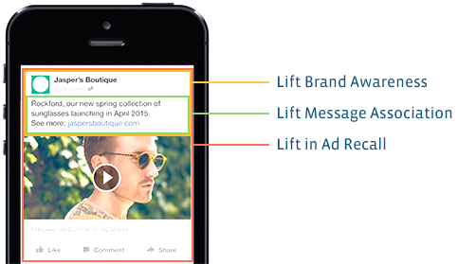
Facebook Brand Awareness Video Campaigns
Video advertising on Facebook allows to
increase number of video views on Facebook for more than 50%
which helps companies to achieve greater brand awareness and increase sales.
You create
3 touch of points
with your client in 1 ad.

Slide 26
How it works?
Video campaigns in Facebook looks like native campaigns and are available on both: desktop and mobile. You can see them every day in your FB feed.
Upload videos directly to Facebook
Use the goal
"Video Views"
Track the effectiveness
of your video
All directly uploaded videos played better and look more attractive compared to other video websites.
30% more video views
Increasing the size of images up to 11 times in the News Feed
When you choose a target "Video Views" your video will be automatically optimized to show the people who are likely to watch it on Facebook.
Increase coverage
Boost your video
Metrics video in the advertising statements available when you click Customize columns, to better understand how to improve the video.
Views video (10 seconds)
Views on quartiles

Slide 27
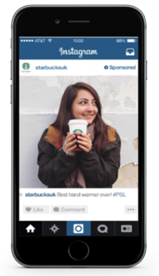
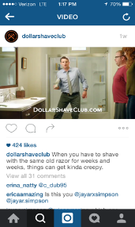
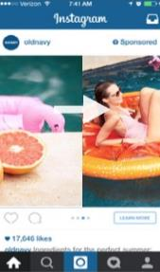
Advertising via Instagram
PHOTO
ADS
VIDEO
ADS
CAROUSEL
ADS
500M+
Monthly Actives
300M+
Daily Actives
4.2B
Likes Daily
95M+
Daily Posts

Slide 28
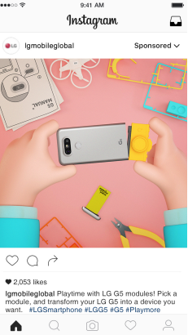
Advertising via Instagram
Launching New Products Case – LG G5 smartphone
Background
LG Electronics is a global leader in consumer electronics, home appliances and mobile communications. Established in 1958, it has since led the way into the modern digital era, releasing industry first mobile technologies and solutions that support its “Life’s Good” brand proposition.
Their Goal
LG wanted to maximize impact of launching newest flagship smartphone LG G5. The aim was to engage with an online audience aged 18-40 and to show them why “Life is Good when you Play More.”
Solution
LG launch G5 video showcases to a visually engaged audience and to trigger user engagement in the lead up to the product being available on shelves.
30M+
Reach across countries
16M+
Reach in strategic countries for LG mobile
1.7M+
Engagements
https://scontent-waw1-1.xx.fbcdn.net/t39.2365-6/14106601_1650139435299917_1423908768_n.pdf

Slide 29
Facebook Audience Insights
How it works?
To access this tool, simply head to your Facebook Ads manager and click on ‘Audience Insights’ in the left-hand menu.
Step 1
Choose your audience
Step 2
Select your segment's parameters
Step 3
Explore the data
Step 4
Save your audience
http://blog.hubspot.com/marketing/facebook-audience-insights-guide#sm.00017wbn7h1dn6cvywf9rm915r6qx

Slide 30
THE END….
Questions?

Slide 31


